Slide 1

Profit Analysis -Regression & Visualizations
Project ID: PTID-CBA-OCT-25-07
Project Code: PRBA-01
VISHNU J

Slide 2
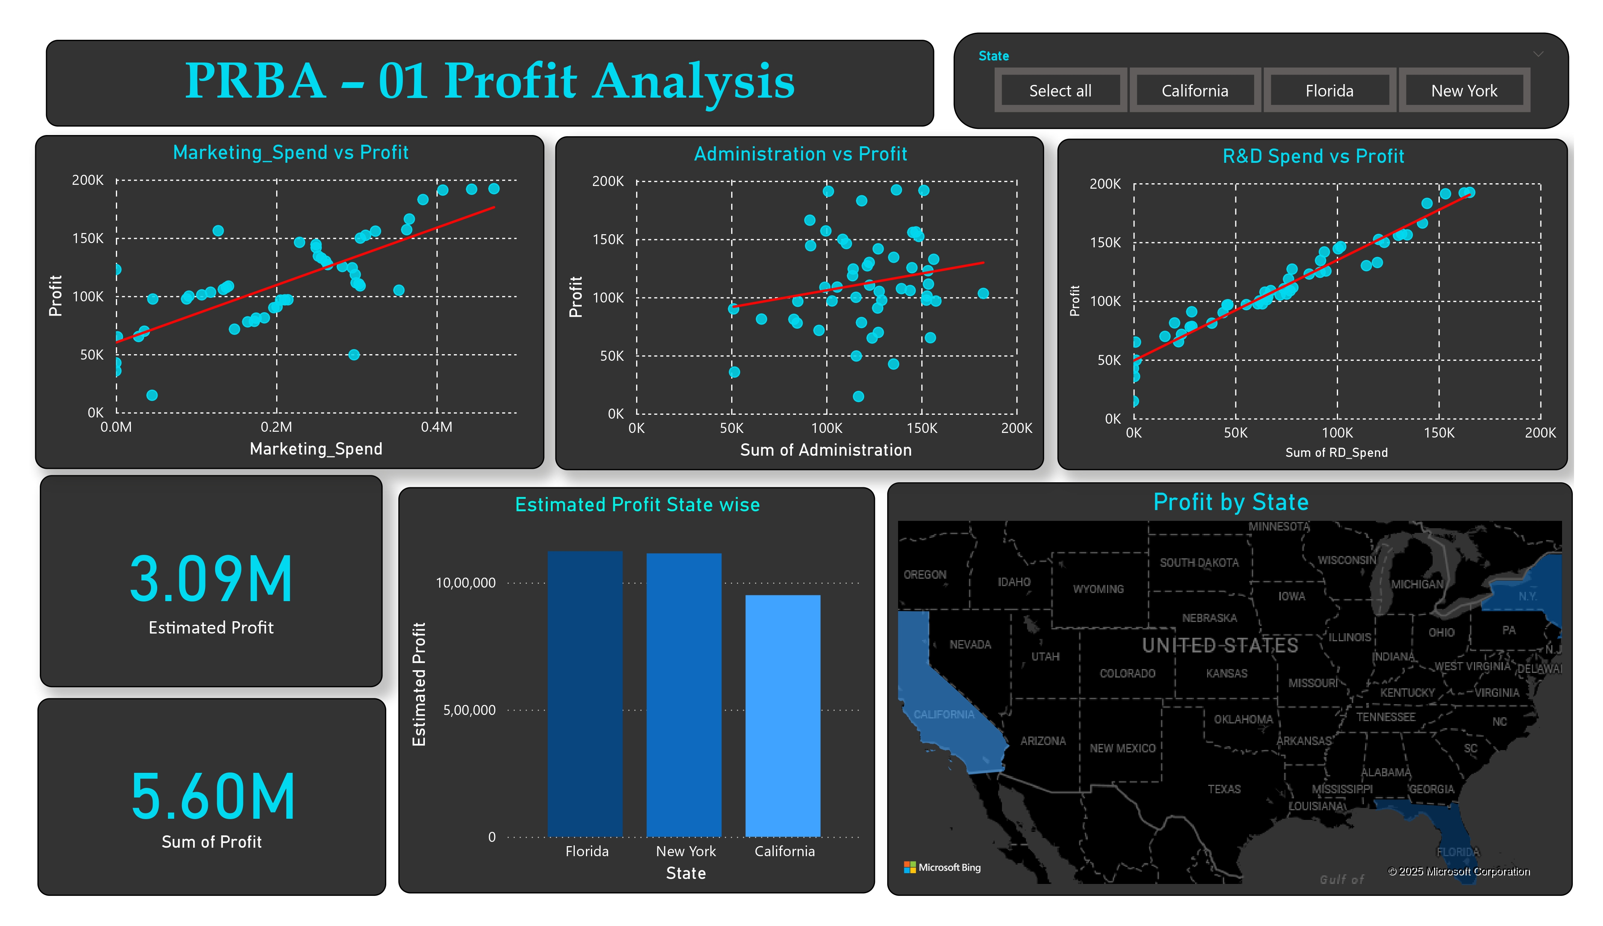
POWER BI INSIGHTS

Slide 3
Regression Results
Variables | Coefficient | Result
Base Profit | 50122 | Expected profit
R&D_spend | 0.80 | Strong positive impact
Administration spend | -0.02 | Negative impact
Marketing spend | 0.02 | Small positive impact
R&D drives profit the most, Marketing contributes moderately, and Administration cost should be controlled.

Slide 4
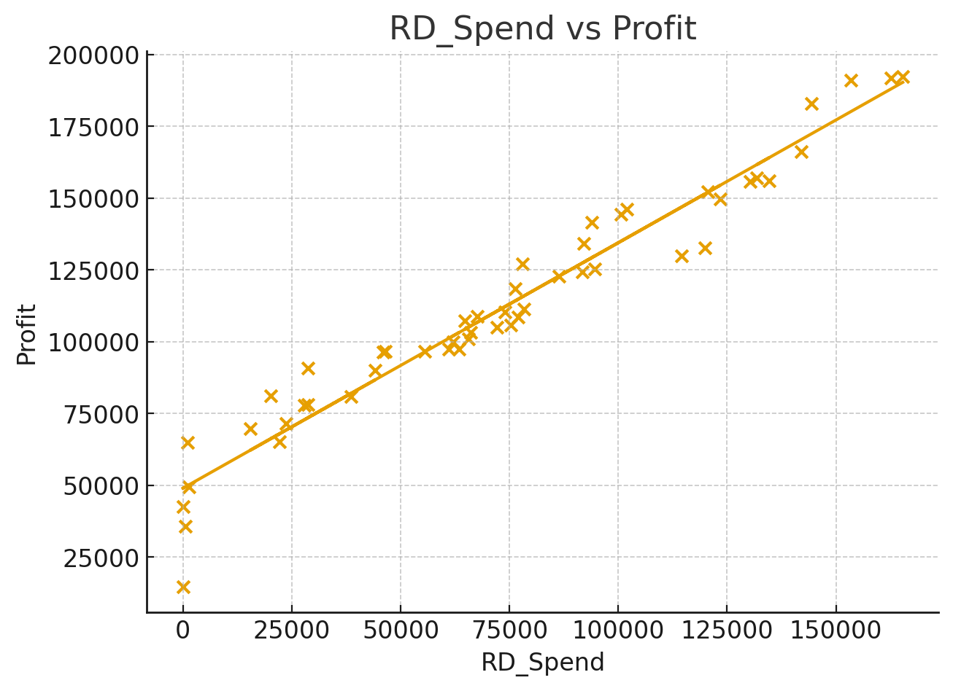
r&D profit
Since R&D Spend has the strongest positive influence on Profit, the company should increase investments in research and development.
This will help improve product quality, innovation, and long-term profitability.

Slide 5
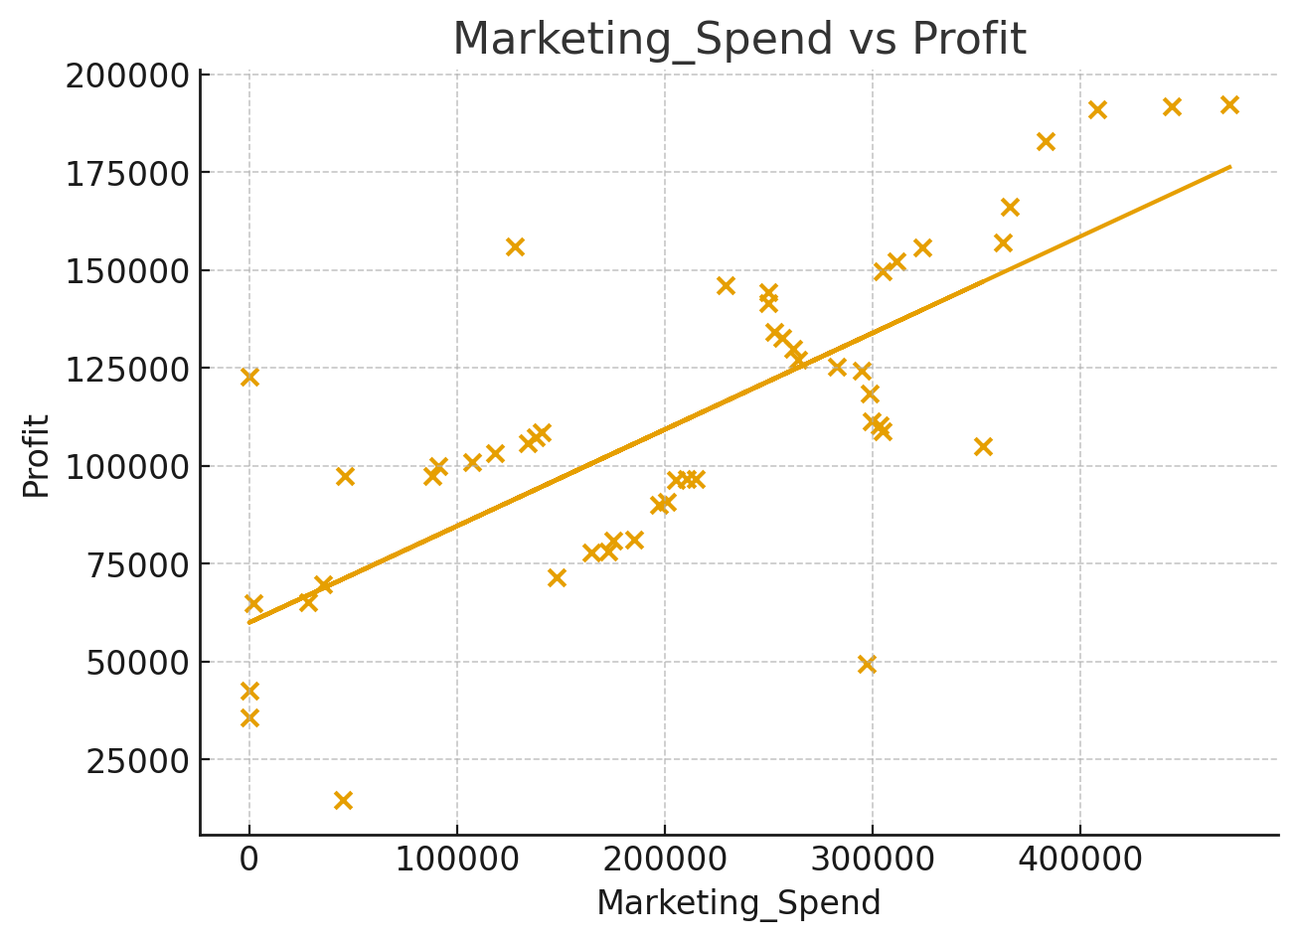
Profit from Marketing Expenditures
Marketing Spend shows a moderate positive impact, meaning campaigns work but are not fully efficient.
Focus on data-driven targeting, digital marketing, and ROI-based budgeting to improve conversion.

Slide 6
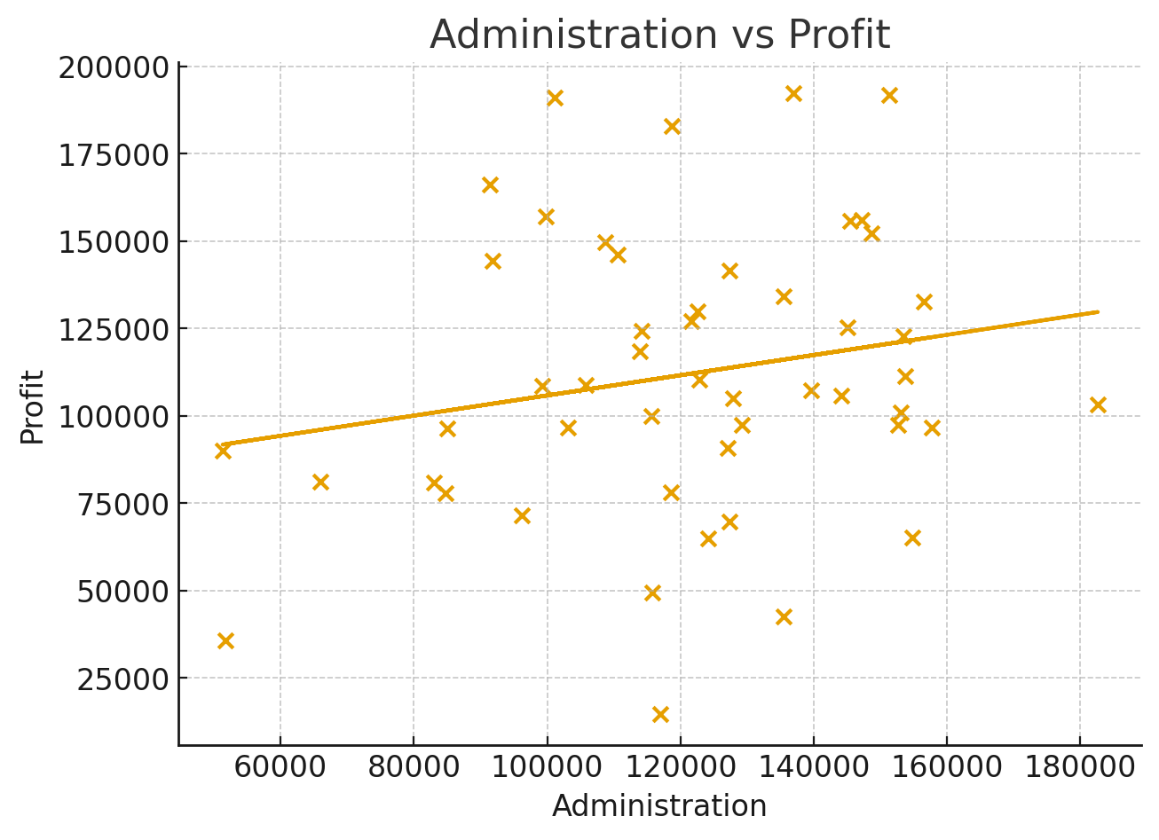
Administration Profit
Administration has a very weak effect on Profit, meaning higher admin expenses are not yielding returns.
Conduct cost-cutting reviews, automate routine tasks, and streamline internal processes to reduce waste.

Slide 7
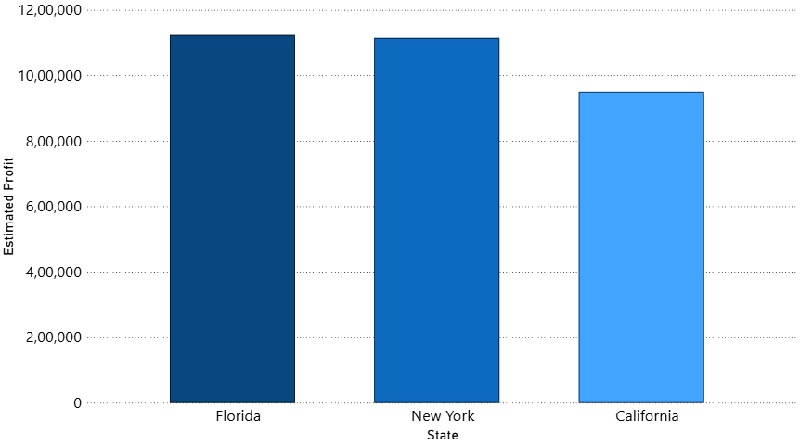
Estimated Profit state wise
Florida and New York show the highest estimated profit levels, indicating stronger market performance and better revenue contribution compared to other regions.
California’s profit is slightly lower, suggesting either higher operational costs or lower sales efficiency in that region.
The difference in profit across states highlights the importance of regional strategy planning.
Based on this trend, the company should prioritize expansion and promotional activities in Florida and New York, while reviewing performance drivers in California.

Slide 8
Key insights & Recommendations
Increase investment in R&D Spend to maximize profit growth.
Optimize Marketing Spend to improve campaign performance.
Reduce or streamline Administration costs as they contribute less to profit.
Focus more on high-performing states like Florida and New York to boost revenue.
Review strategy and cost structure in California to improve profit levels.
Continuously monitor spending vs profit impact to ensure efficient resource allocation.

